Slide 1

Animal Species Identification System
Using Image Recognition and Deep Learning Models for automated, accurate wildlife classification — supporting conservation, research, and ecological monitoring at scale.
ACADEMIC PROJECT
COMPUTER VISION · DEEP LEARNING · CONSERVATION TECH

Slide 2

Why Accurate Species Identification Matters
Wildlife Conservation
Track endangered populations and detect illegal poaching activity through automated monitoring.
Biodiversity Research
Document species distribution across ecosystems to support ecological modeling and policy.
Veterinary Services
Rapidly identify unknown specimens to guide diagnosis, treatment, and quarantine protocols.
Environmental Protection
Monitor invasive species and habitat changes in near real-time for proactive intervention.

Slide 3
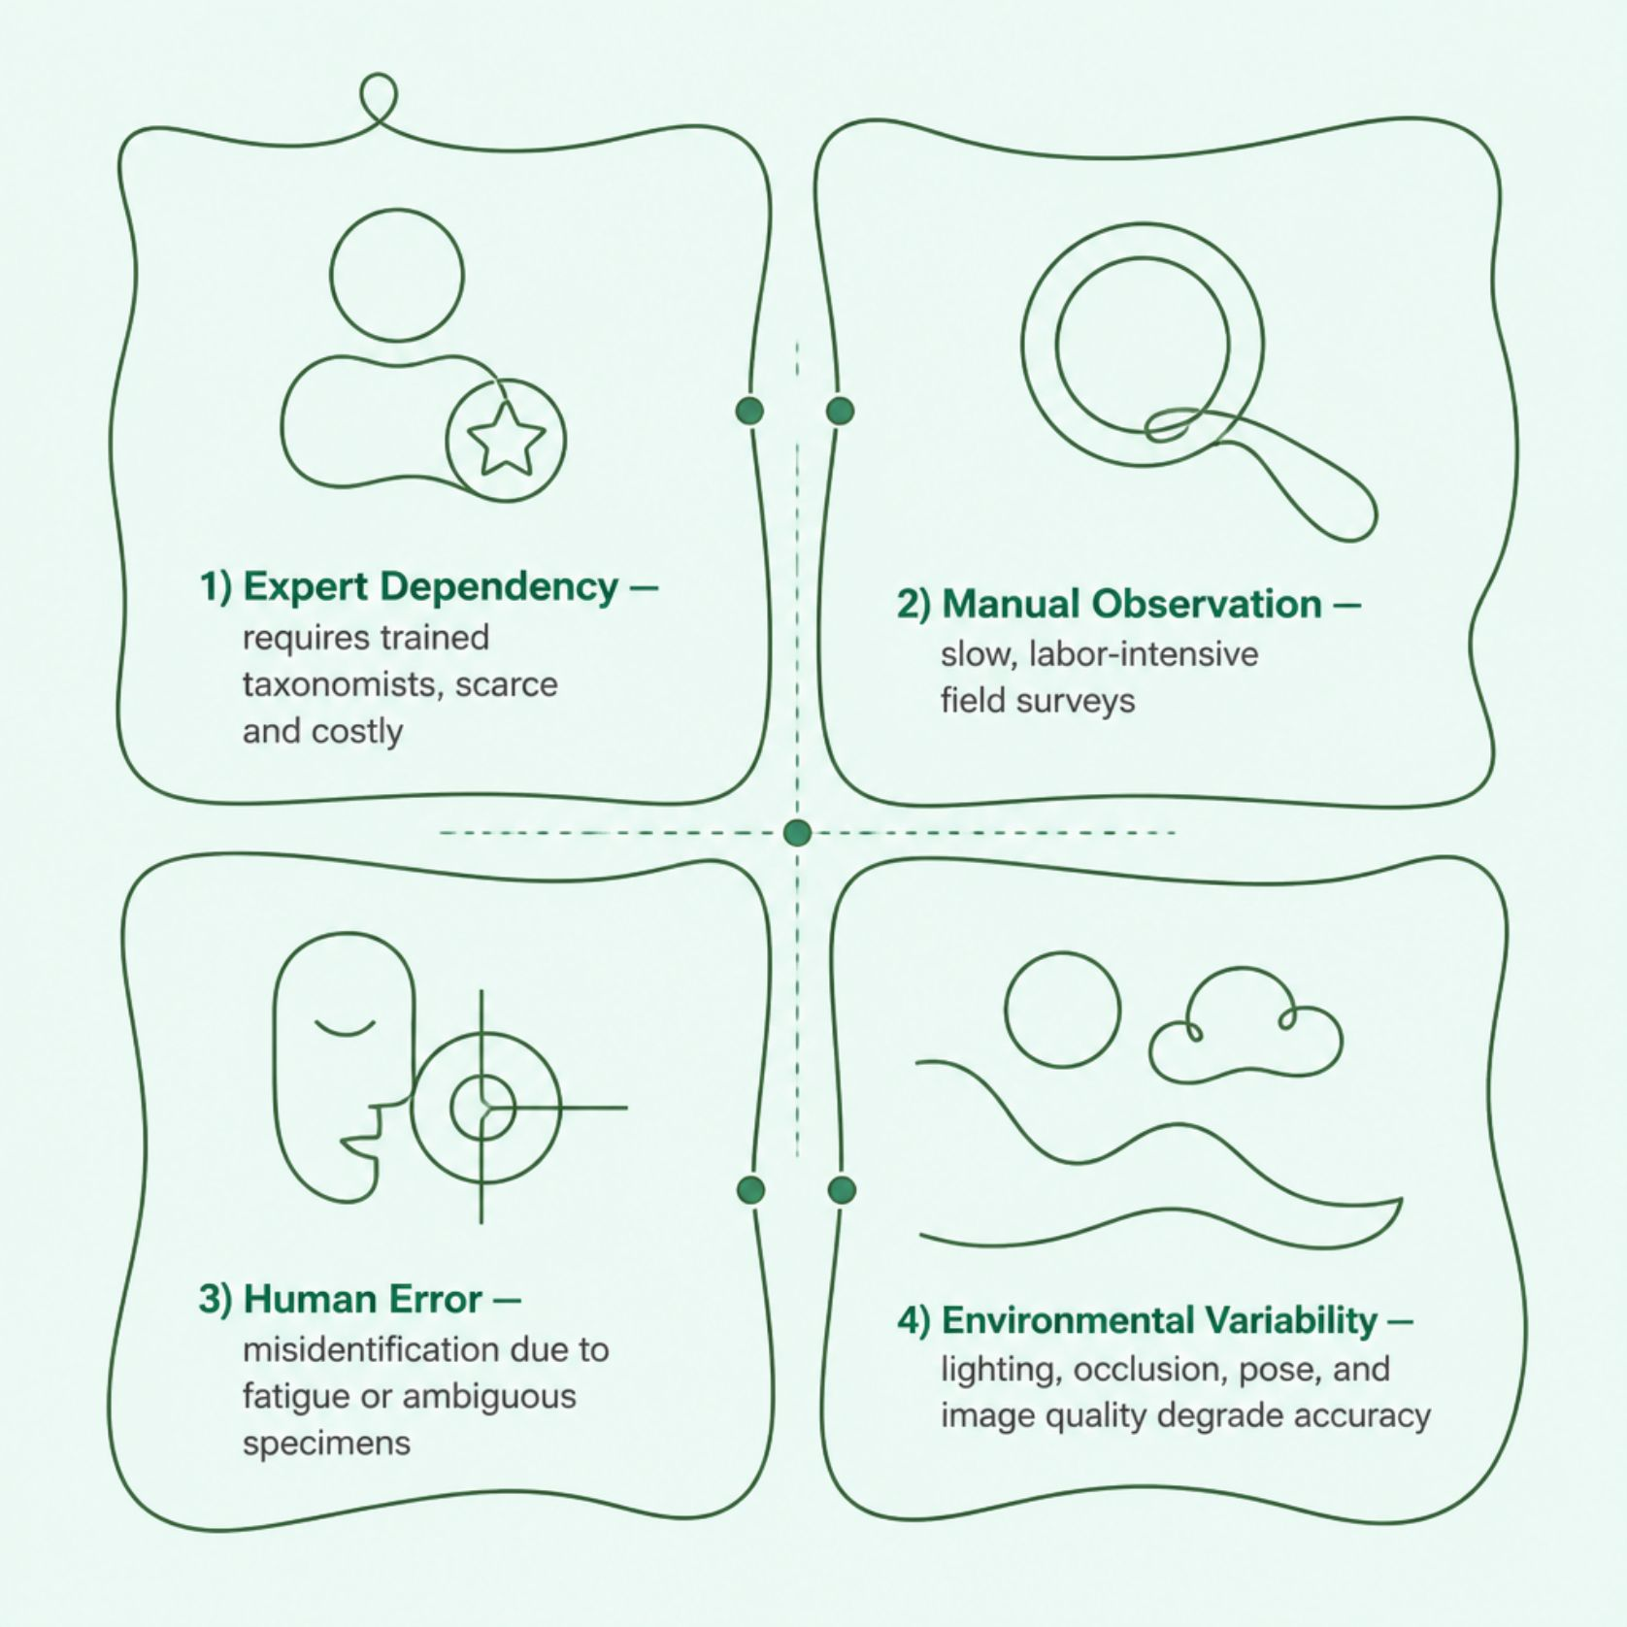
Limitations of Traditional Methods
The Core Challenges
Traditional approaches rely on manual taxonomy, field observation, and expert review — processes that are slow, expensive, and error-prone.
Requires scarce taxonomic expertise
Time-intensive field surveys
High misidentification rates under poor conditions
Cannot scale to millions of camera-trap images
Appearance variation (age, sex, lighting) confounds manual classification

Slide 4

System Architecture & Workflow
The system follows an end-to-end deep learning pipeline: uploaded images are preprocessed, passed through a CNN-based classifier, and returned with a predicted species label and confidence score.
Feature Extraction
Image Upload
Preprocessing
Each stage is modular and independently testable, enabling iterative model improvement and deployment flexibility across cloud or edge environments.

Slide 5
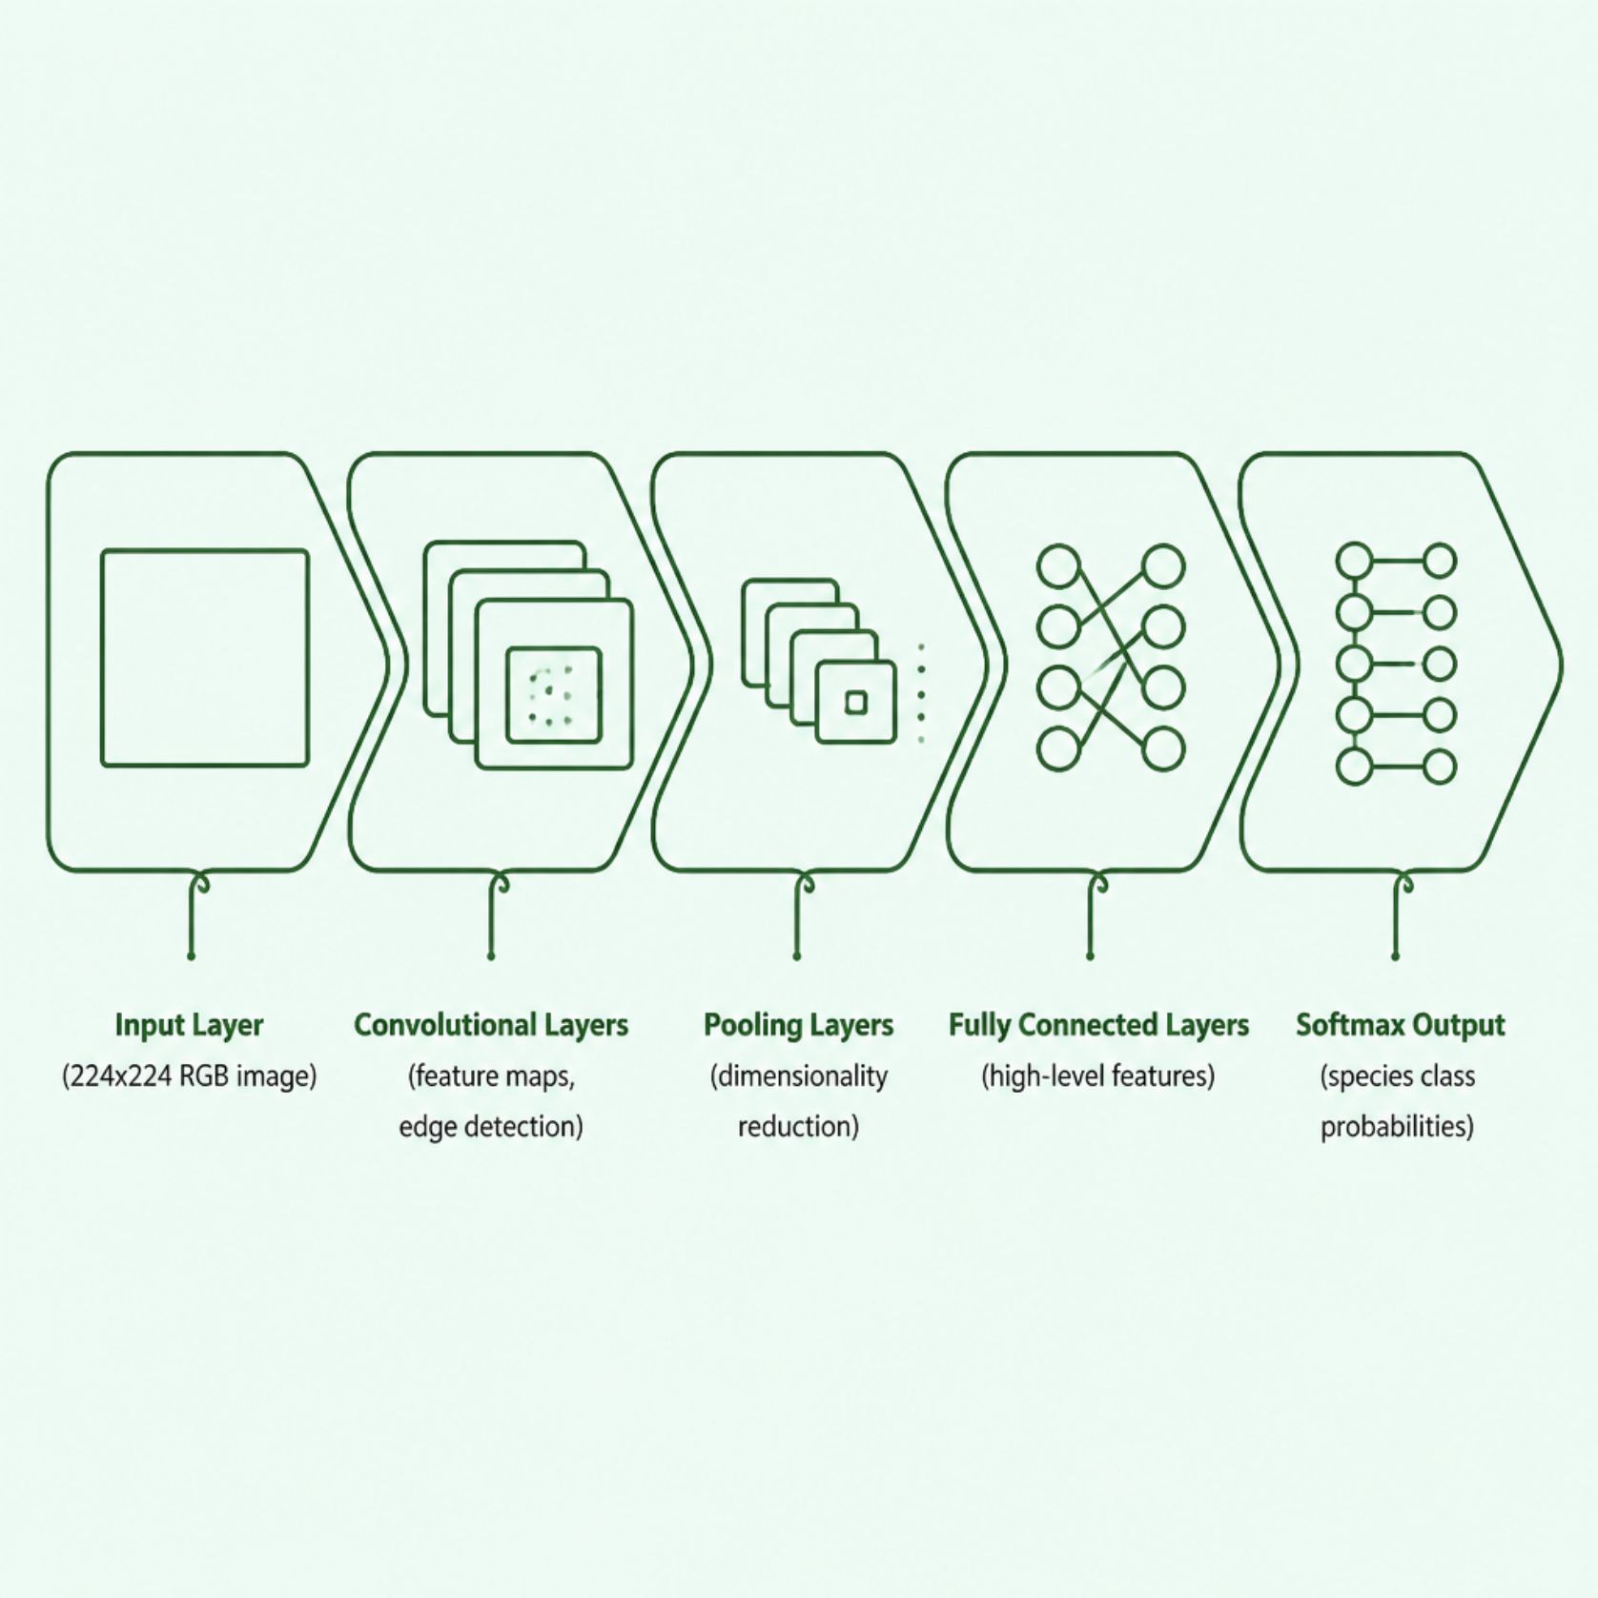
Image Processing & CNN Architecture
Preprocessing Techniques
Resize & normalize pixel values
Data augmentation: flip, rotate, zoom
Background removal & noise reduction
Feature Extraction
Transfer learning: ResNet50, VGG16, EfficientNet
Custom CNN for domain-specific features
Grad-CAM for interpretable saliency maps

Slide 6
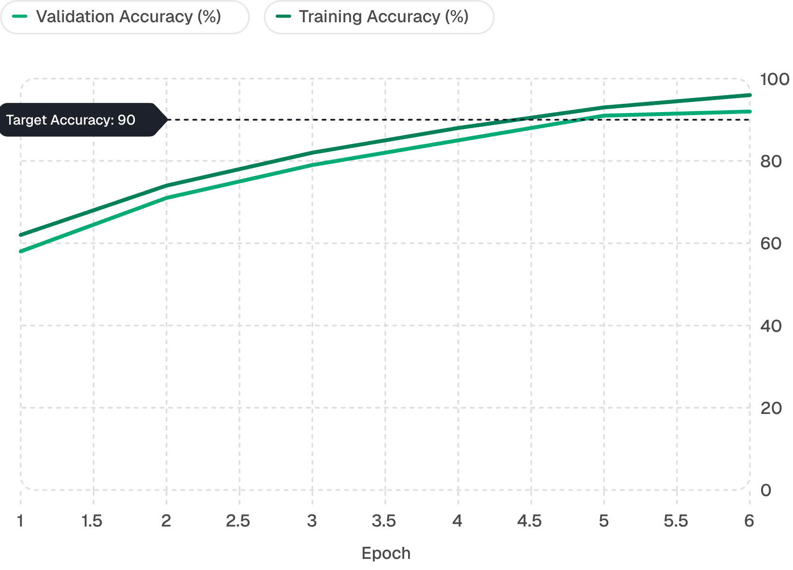
Model Training, Validation & Evaluation
Training Protocol
Models trained on iNaturalist and Caltech-UCSD datasets (500K+ labeled images across 10,000 species). Augmentation mitigates class imbalance.
Evaluation Metrics
Top-1 & Top-5 Accuracy
Precision, Recall, F1-Score per class
Confusion matrix for error analysis
ROC-AUC for multi-class discrimination

Slide 7

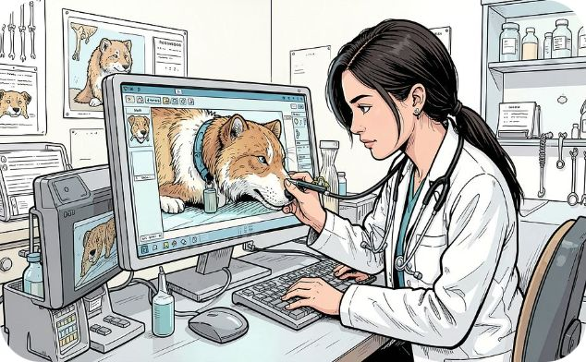

User Roles & System Modules
Researchers & Field Biologists
Veterinarians
Administrators
Identify unknown specimens, access species-specific health profiles, and generate clinical reports with prediction evidence.
Manage user access, monitor model performance dashboards, curate training datasets, and trigger retraining pipelines.
Upload camera-trap images, receive instant species predictions with confidence scores, and export labeled datasets for analysis.

Slide 8
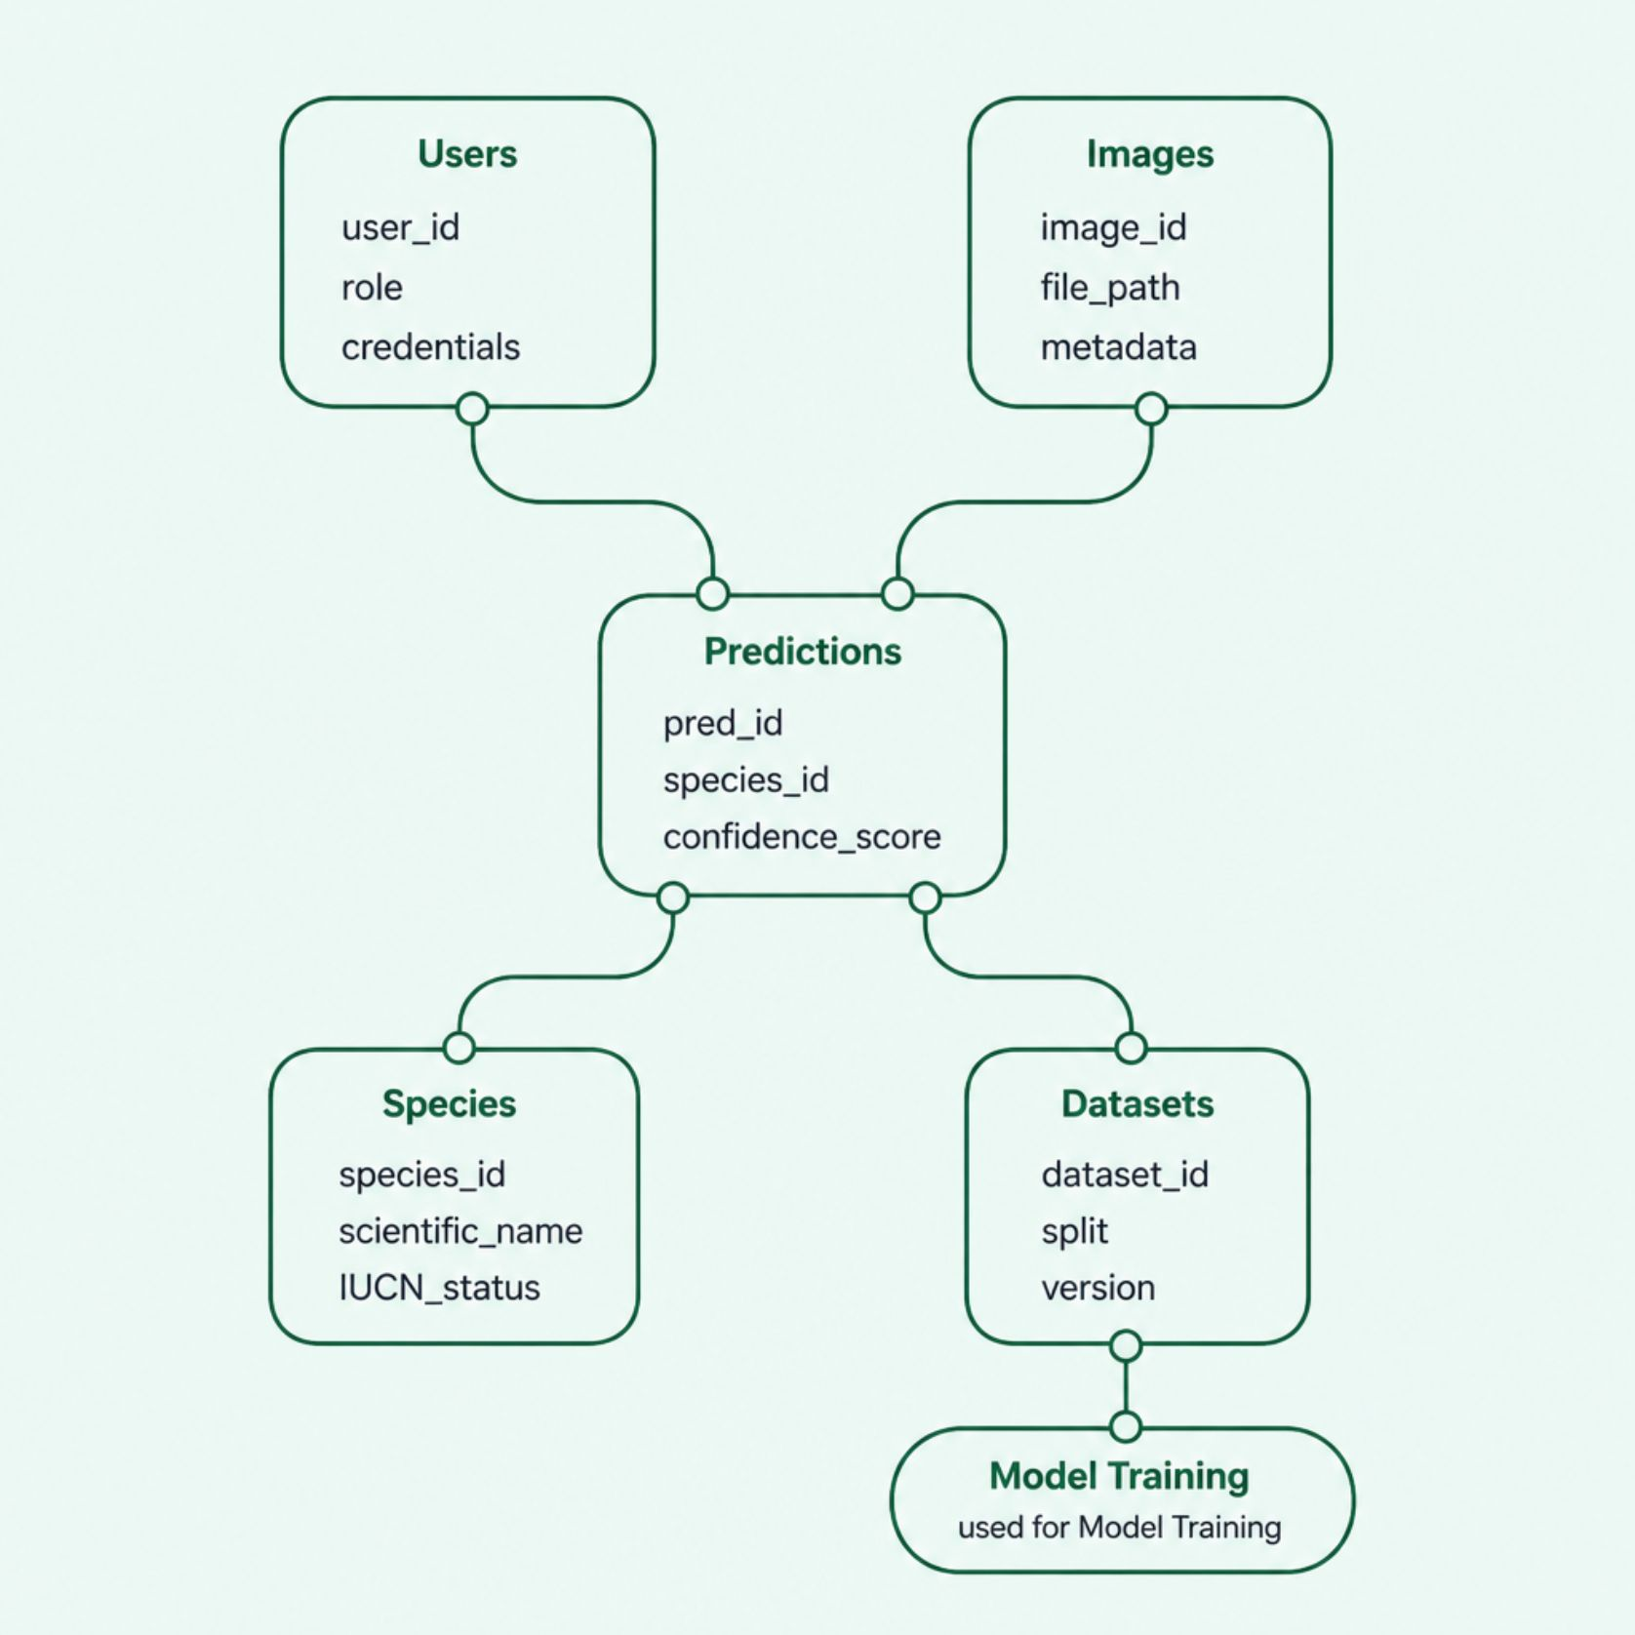
Database Design & Security
Core Data Entities
Users — role-based authentication (JWT + OAuth2)
Images — metadata, upload timestamp, source
Predictions — species label, confidence, model version
Species — taxonomy, conservation status, references
Datasets — training splits, labels, augmentation logs
All image data is encrypted at rest (AES-256) and in transit (TLS 1.3). Role-based access control (RBAC) ensures researchers only access authorized datasets.

Slide 9
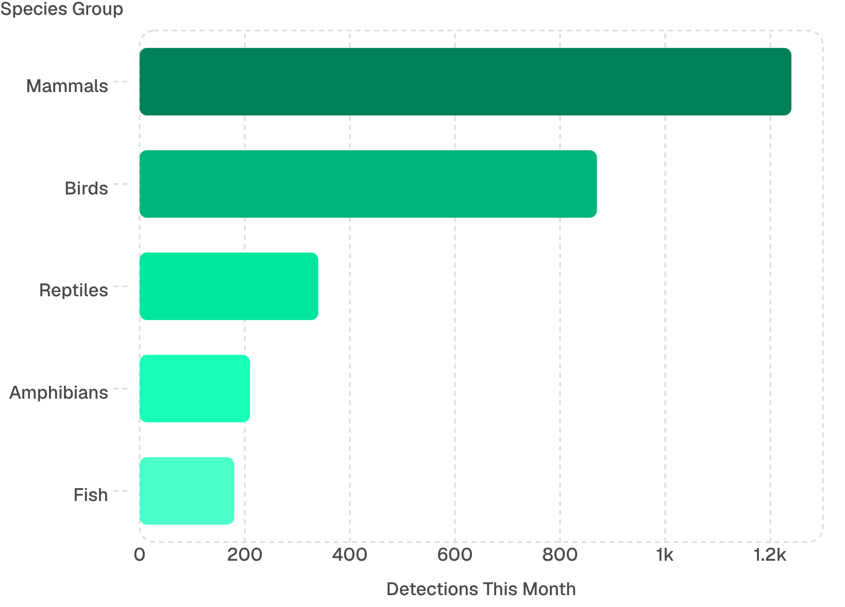
Analytics Dashboard & Reporting
Dashboard Capabilities
Real-time species detection counts by taxonomy
Geospatial heatmaps of observation locations
Model drift monitoring & retraining alerts
Exportable PDF reports with prediction evidence
Confidence distribution & error rate trends
Reporting Features
Automated weekly summaries for conservation stakeholders, including rare species alerts and population trend indicators.

Slide 10
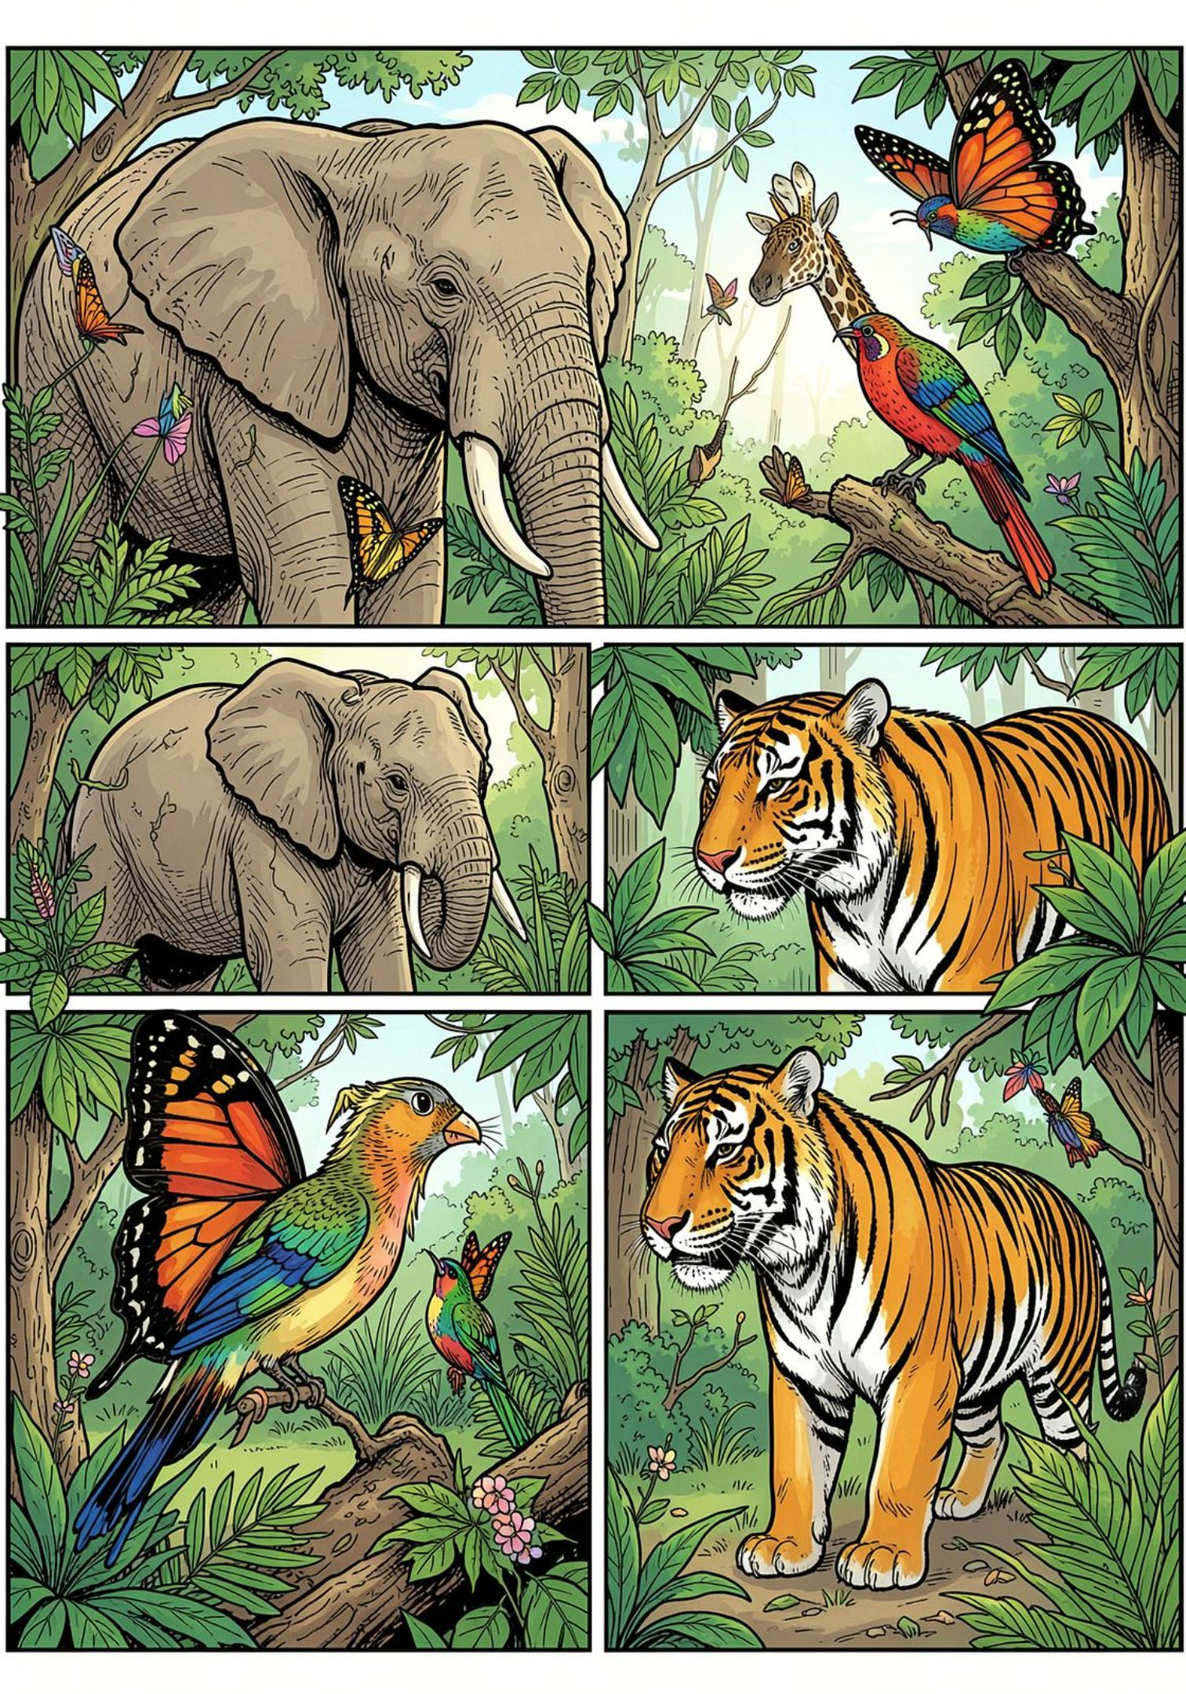


Outcomes, Applications & Future Directions
Expected Outcomes
Target Top-1 accuracy >90% on benchmark datasets. Inference under 2 seconds per image on GPU-enabled servers.
Real-World Applications
Deployable in wildlife reserves, zoos, veterinary clinics, biodiversity surveys, and environmental NGOs for automated species monitoring.
Future Enhancements
Video-based tracking, multi-species detection in single frames, low-resource edge deployment, and integration with citizen science platforms like iNaturalist.
Key Advantage: This system democratizes species identification — enabling non-experts to contribute high-quality data to global conservation efforts.

